Slide 1
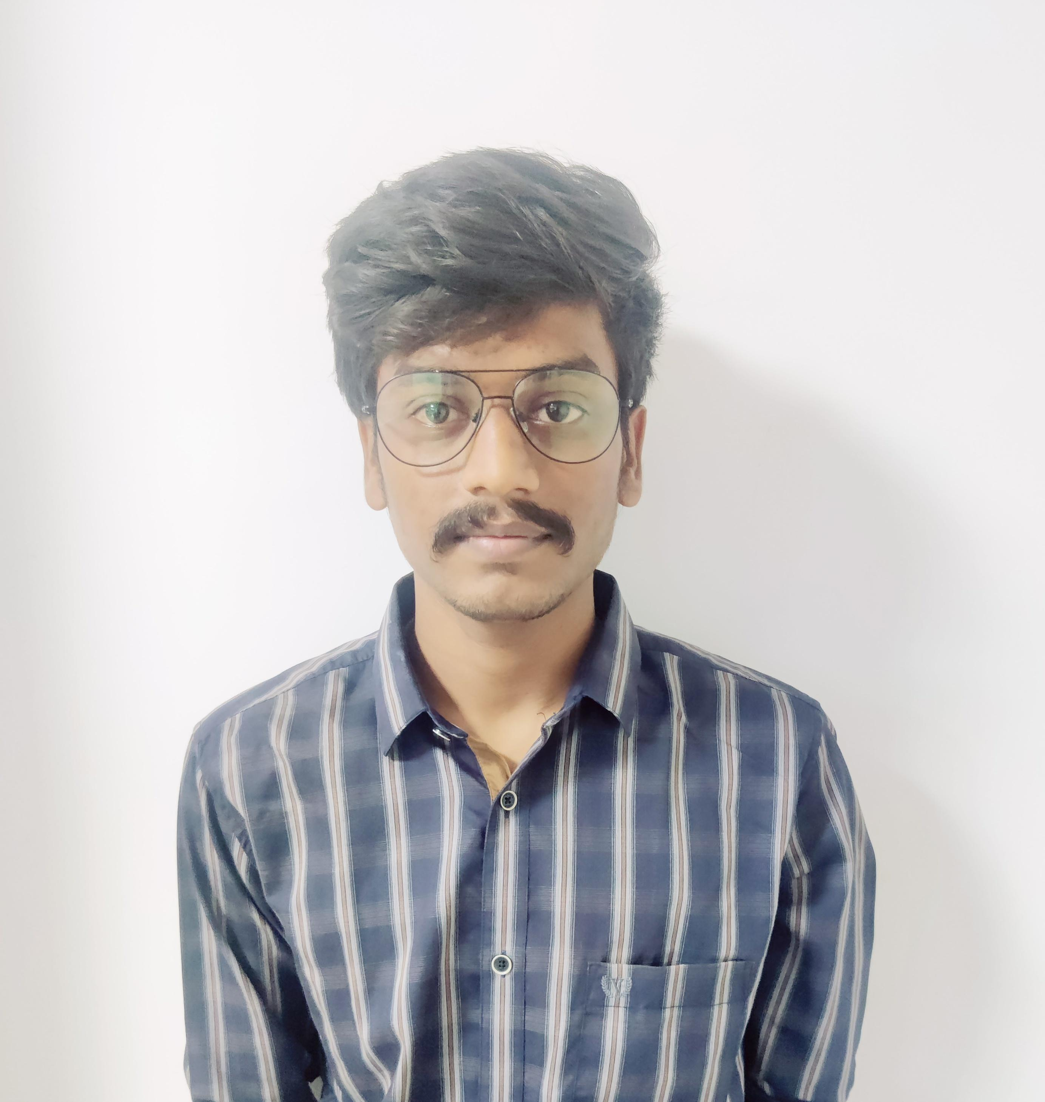

Ajay kumar G
Analyst/Software Engineer
Bachelor of Engineering
Computer science and engineering: 2017 - 2021
Skills
javascript basics
React Components, Hooks, Event handling, Redux, Reducers, Testing using Jasmin & Karma
Angular Components, Services, Modules, Routing, Forms & Validation, Testing using Jasmine & Karma
Database MongoDB
UI Tech
HTML5
CSS3
Javascript
Tools GitHub , Postman
Cloud technologies Amazon web service
Additional Details
Communications, Team management. Peer learning
Hyderabad
Gonuguntla.ajay-kumar@capgemini.com
+91 9440919073
A4
Hands on experience in developing web pages
using HTML5, CSS3, Object Oriented Java script, ES6,
JQuery, JSON.
MEAN(Mongo, Express, Angular, NodeJS)
Proficient in creating Single page Web Application in Angular with Authentication with route guards, Angular reactive forms, angular routing, Tailwind CSS
Hands on experience in implementing Nodemailer
architecture with NodeJs.
Implemented Javascript, Nodejs and ExpressJs in case
study and upskilling my knowledge continuously.
SMART UI BUILDER CHAT BOT Application
Completed assigned task case study of Smart UI Builder Chat Bot Application along with JWT authentication, responsive UI, CSS, Bootstrap template and Angular used for user interface.
CMS Application:
Completed end to end case study of Content Management System Application during training period by using Angular, NodeJS, Express, Mongo Database etc.
Certification’s
Agile Software Development
AWS Cloud Practitioner

